Slide 1
Regulatory Affairs of Road Accident Data 2020
Road safety is a critical concern in urban areas, especially in cities with high traffic density. Analyzing accident data helps in identifying trends, causes, and outcomes of incidents, allowing authorities to implement effective safety measures. This project focuses on understanding the distribution of road accident outcomes, particularly minor injuries, across various cities. By analyzing this data, we can gain insights into which cities experience higher incidents of minor injuries and assess the impact of different cause categories on road safety.
-- by Priya Rajurkar

Slide 2
Project Overview
This project aims to analyze the distribution of incidents across various cities, focusing only on those where the count exceeds 15 cases. By filtering and ranking cities based on their incident frequency, we can identify areas with a higher occurrence of minor injuries and assess the underlying factors contributing to these accidents. Understanding these patterns is essential for recognizing high-risk urban zones and addressing road safety concerns effectively.
Using SQL-based data analysis, the project extracts meaningful insights from road accident records, categorizing incidents by city and cause. This structured approach allows us to pinpoint cities with frequent minor injury cases and examine which cause categories are most prevalent. The findings can help policymakers, traffic authorities, and urban planners develop targeted safety measures to reduce road accidents and improve overall traffic management.

Slide 3
Technology used
This project primarily utilizes SQL for querying and analyzing road accident data. SQL is used to extract meaningful insights by filtering, grouping, and ranking cities based on the number of incidents. Various SQL functions such as COUNT(), GROUP BY, ORDER BY, and conditional filtering help in identifying trends related to minor injuries across different cities. Through these queries, we can determine which cities report the highest number of minor injury incidents and analyze the contributing factors.
Additionally, Excel is used for an initial overview of the dataset, specifically to check the structure and available columns. This helps in understanding the data before writing SQL queries for analysis. Lastly, PowerPoint is utilized to present findings in a visually structured format, making it easier to communicate insights, trends, and recommendations effectively. By leveraging these technologies, the project ensures a systematic approach to data analysis and presentation.

Slide 4
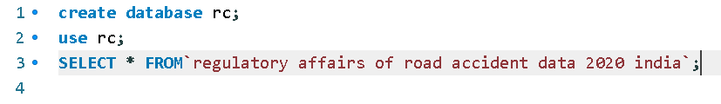
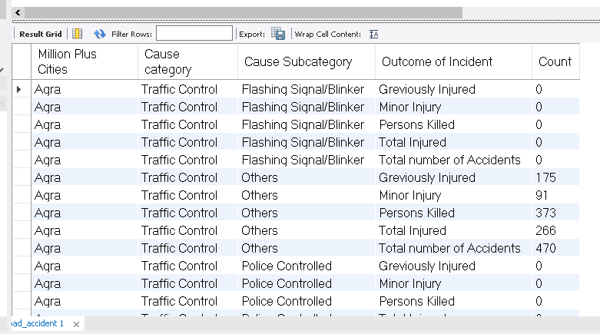

Quires
1] Import & View Table

Slide 5
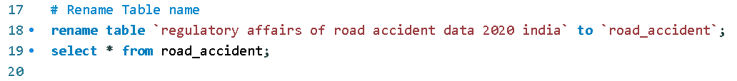
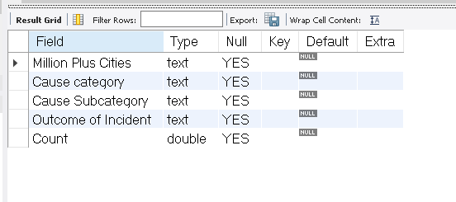


2] Rename The Table
3] Check Data-Types

Slide 6
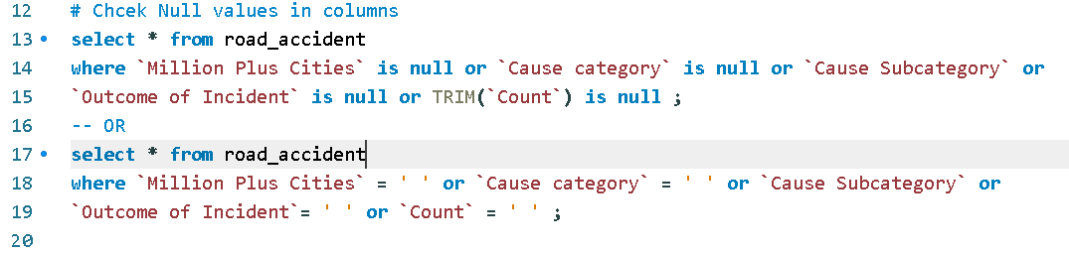
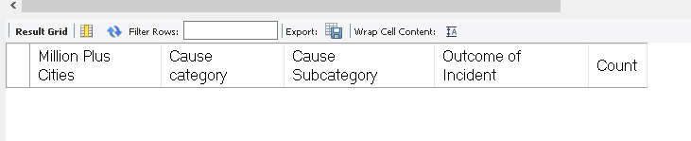
4] Check Null Values

Slide 7

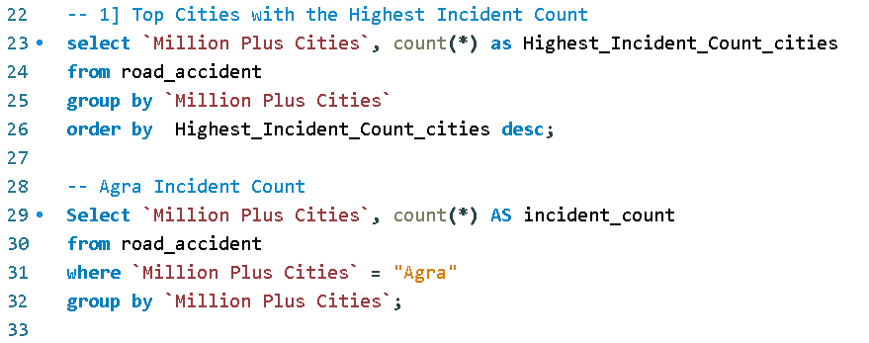
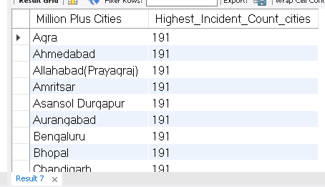
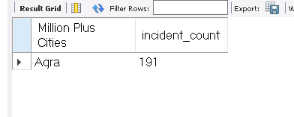
5] Top Cities with the Highest Incident Count

Slide 8
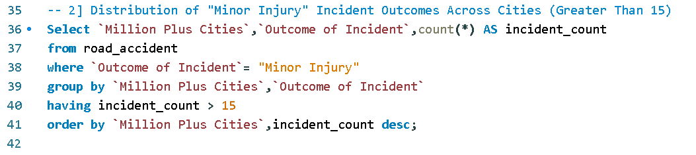
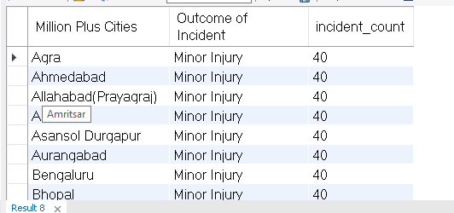
6] Distribution of "Minor Injury" Incident Outcomes Across Cities (Greater Than 15)

Slide 9
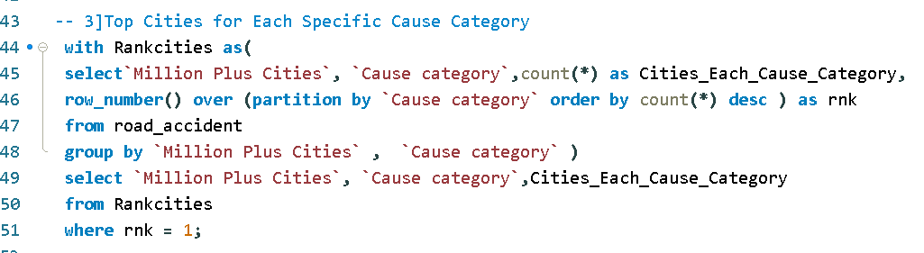
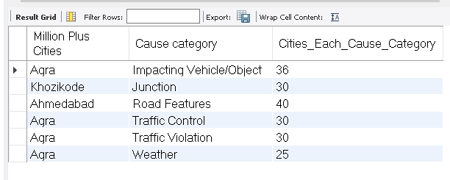
7] Top Cities for Each Specific Cause Category

Slide 10
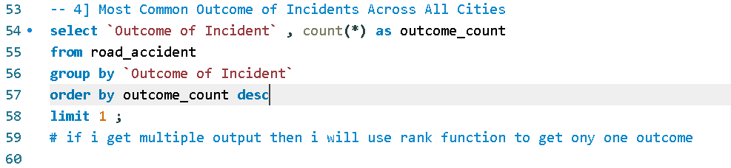
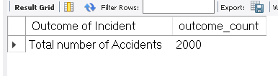
8] Most Common Outcome of Incidents Across All Cities

Slide 11
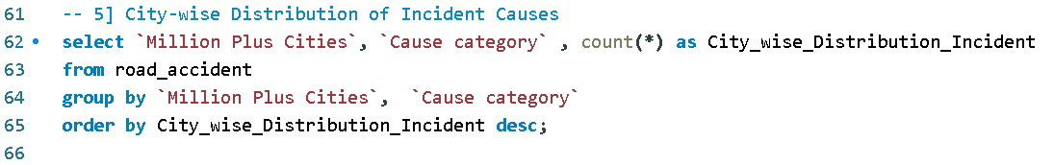
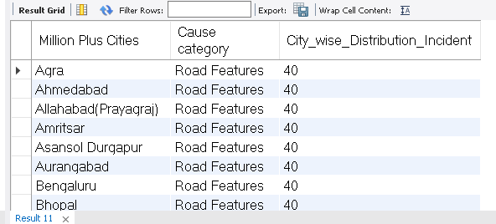
9] City-wise Distribution of Incident Causes

Slide 12
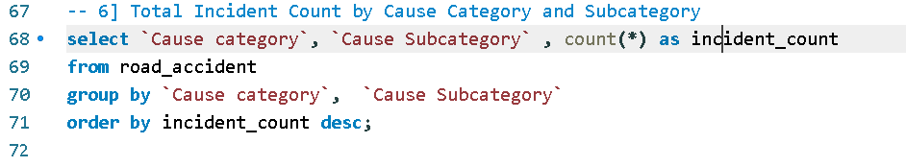
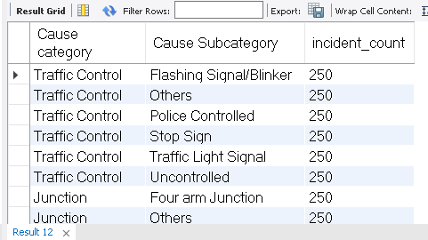
10] Total Incident Count by Cause Category and Subcategory

Slide 13
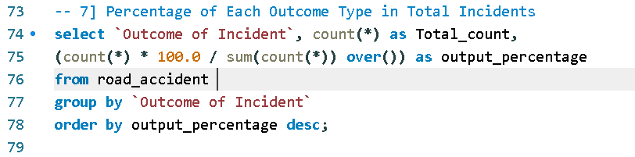
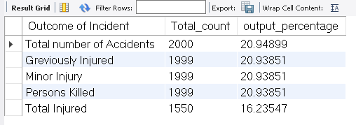
11] Percentage of Each Outcome Type in Total Incidents

Slide 14
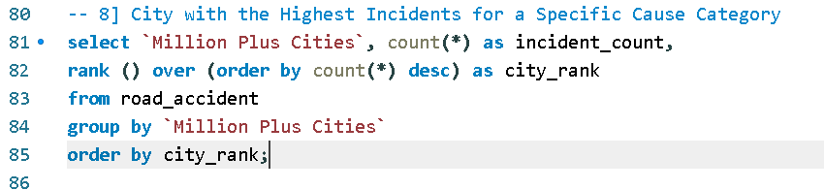
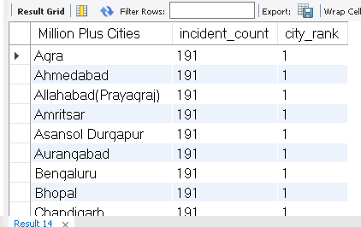
12] City with the Highest Incidents for a Specific Cause Category

Slide 15
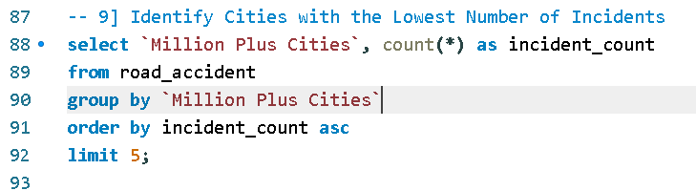
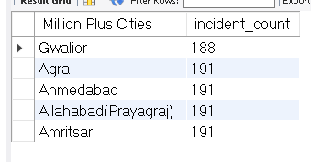
13] Identify Cities with the Lowest Number of Incidents

Slide 16
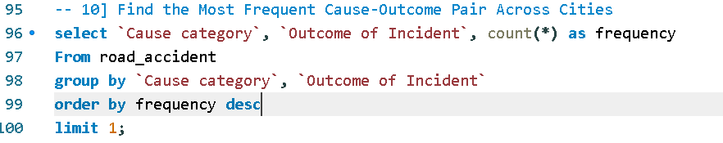
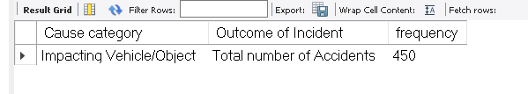
14] Find the Most Frequent Cause-Outcome Pair Across Cities

Slide 17
Summary
This project analyzed road accident data to examine the distribution of incidents across cities.
Using SQL, we identified cities with more than 15 minor injury cases and ranked them based on incident count.
The study highlighted high-risk cities and provided insights into the most common causes of minor injuries.
Findings from the analysis can help policymakers and traffic authorities implement targeted road safety measures.
The results have been presented in a structured format to support data-driven decision-making.

Slide 18
Thank you for your time and attention!
Feel free to ask any questions or share your thoughts.
Looking forward to discussions and insights!

